Slide 1

Managing Performance
Webinar 2
Martin Pike

Slide 2

Learning Outcomes
At the end of this session, you should be able to:
Prepare profit and loss account and statement of financial position
Identify the major categories of ratios that can be used for analysing financial statements
Calculate key ratios for assessing the financial performance and position of a business
Explain the significance of the ratios calculated
Discuss the limitations of ratios as a tool of financial analysis

Slide 3
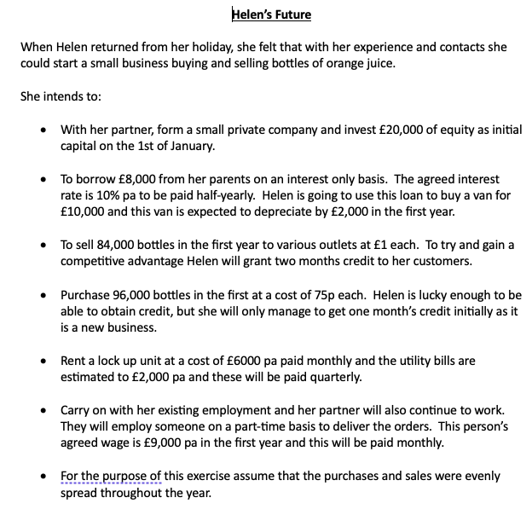

Slide 8
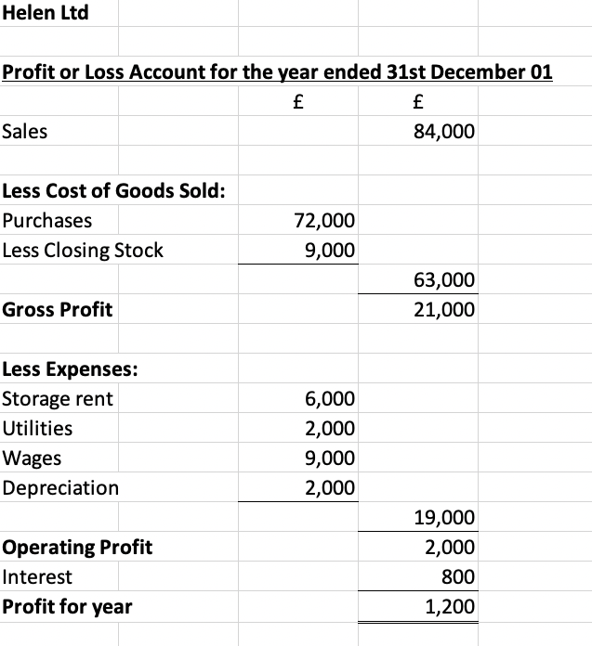
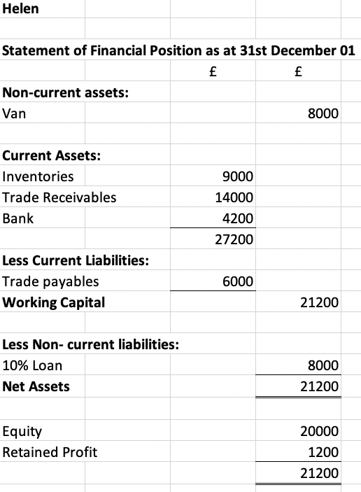




PROFIT RATIOS
25%
6.8%
2.4%
5.7%

Slide 9




LIQUIDITY RATIOS
4.5:1
27.4%
3:1
2.5 Times

Slide 10
EFFICIENCY RATIOS
61 Days
52 Days
30 Days
2.9 Times

Slide 11
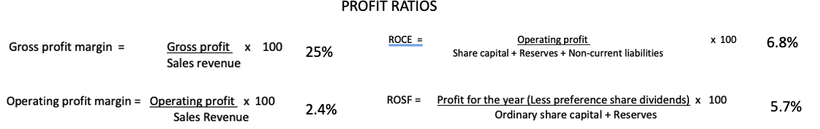
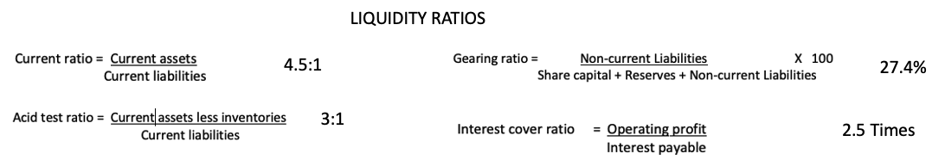
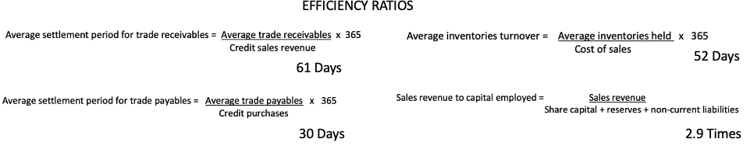
Helen’s Ratio Summary

Slide 12
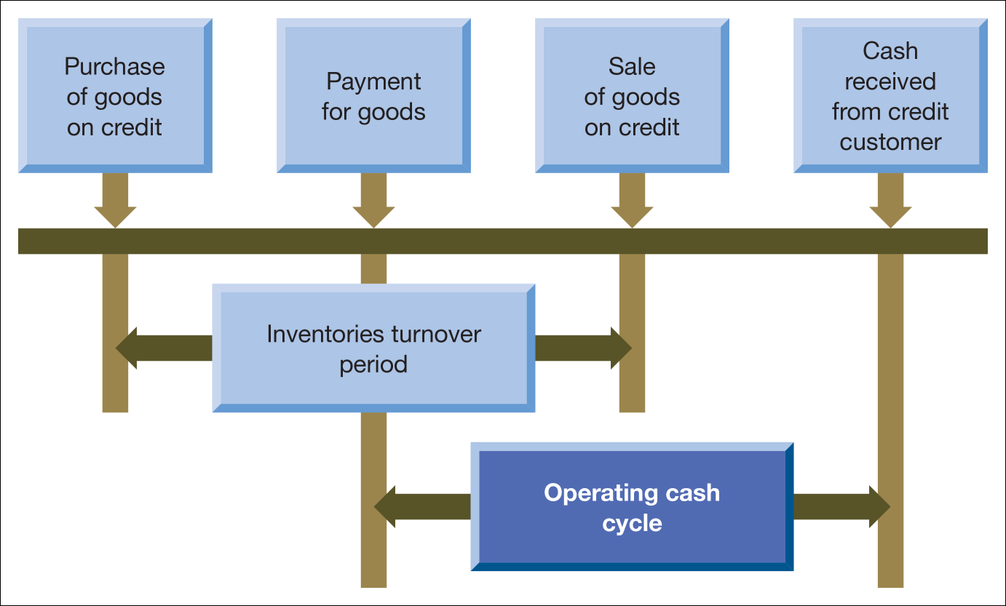
The Operating Cash Cycle

Slide 14
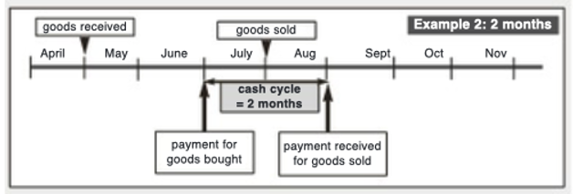
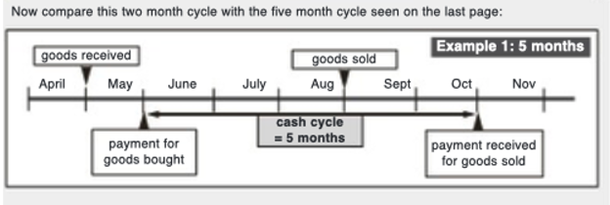

Slide 15
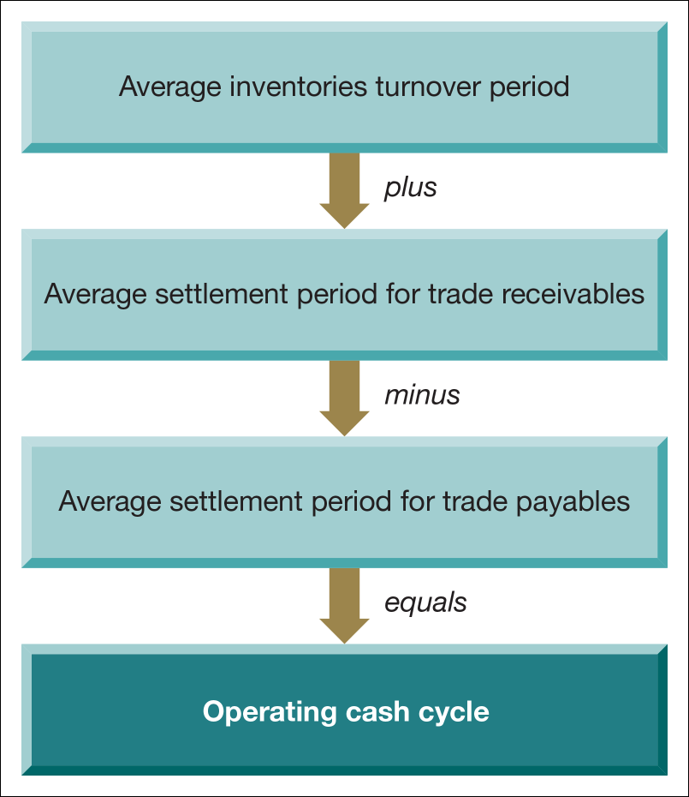
Calculating the operating cash cycle

Slide 16



Helen’s Operating Cash Cycle
52 Days + 61 Days – 30 Days = 83 Days Between paying and receiving cash

Slide 17
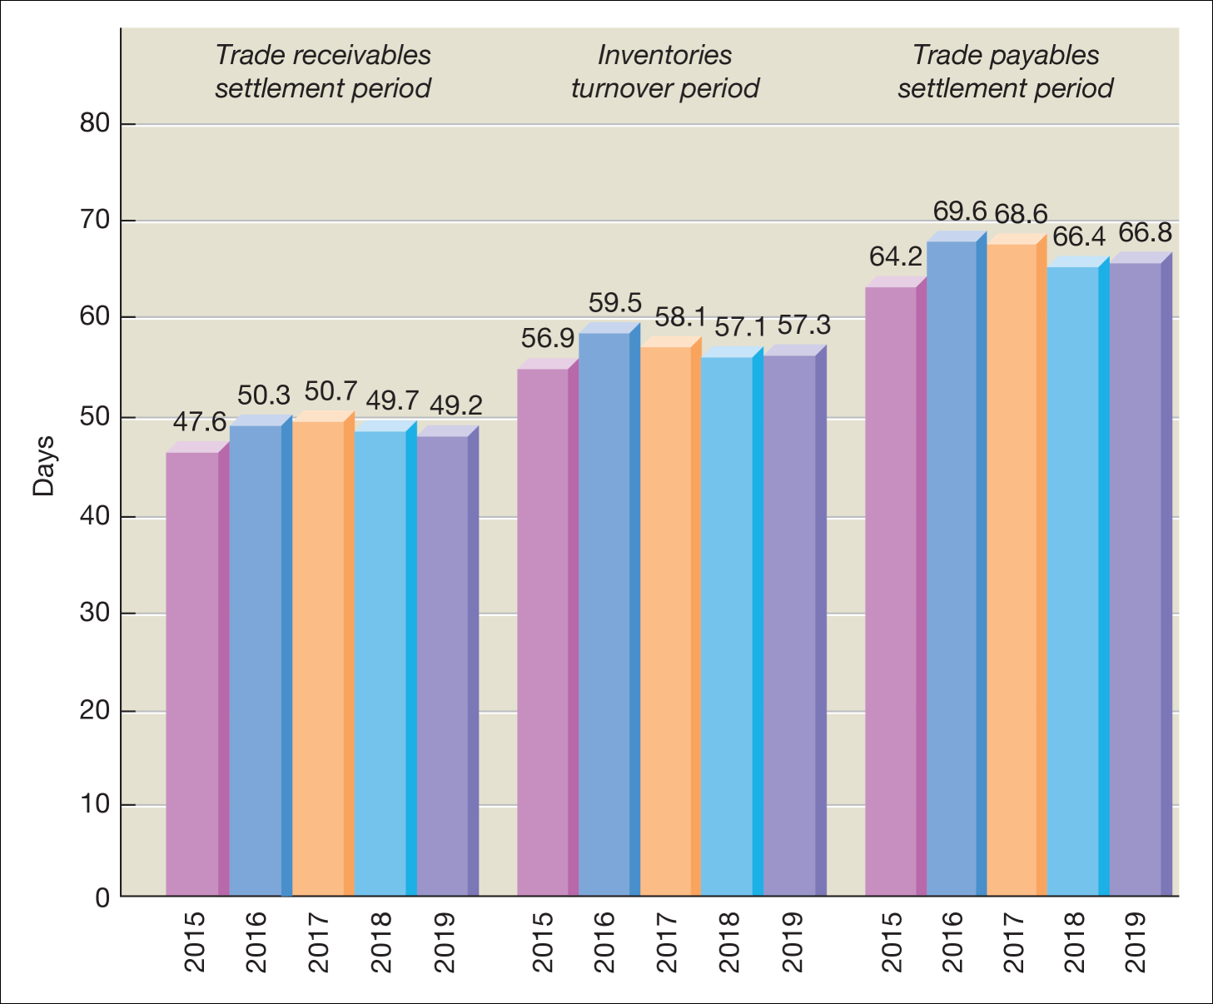
Average investment (in days) for the main working capital elements
Source: Compiled from information in PwC (2021) Working Capital Study 2020/2021: Act Now to Recover, www.pwc.com.

Slide 18
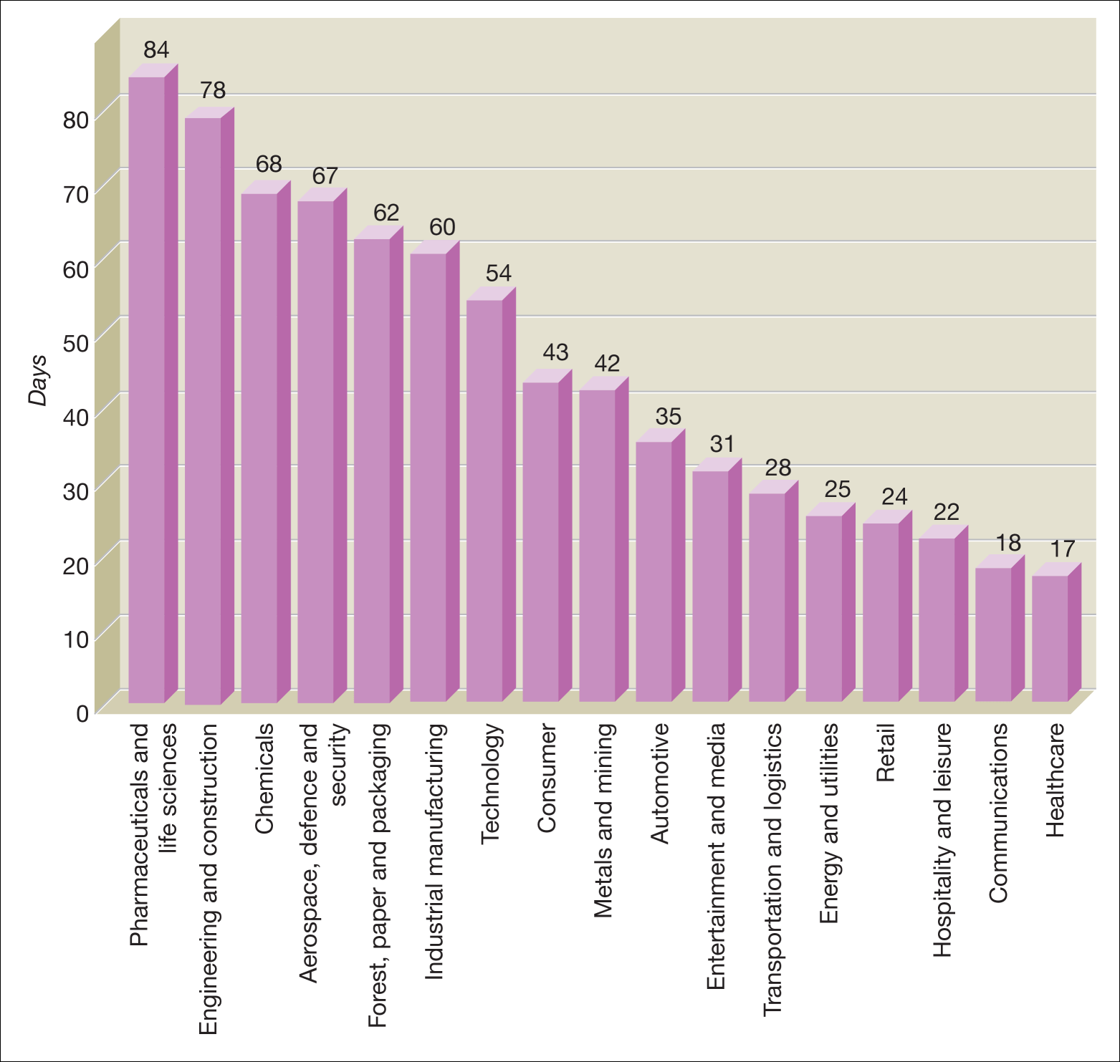
The average OCC of large businesses analysed by industrial sector
Source: Figure based on information contained in PwC (2021) Working Capital Study 2020/2021: Act Now to Recover, www.pwc.com.

Slide 19
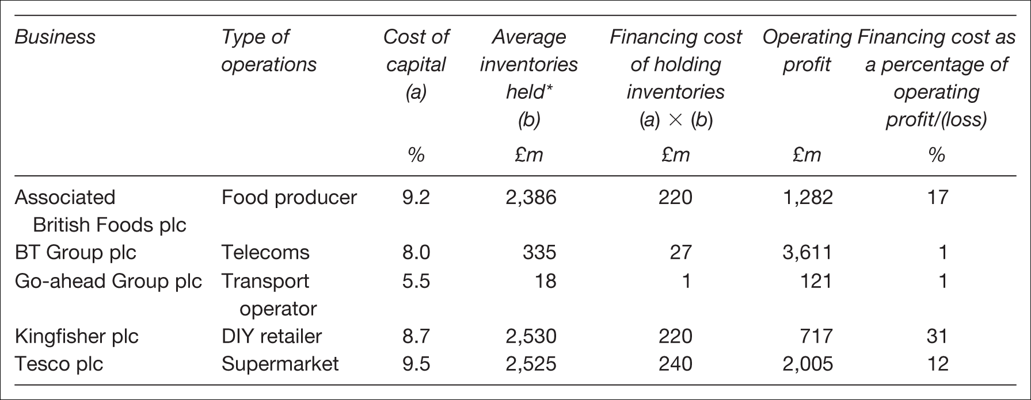
Inventories financing cost

Slide 20
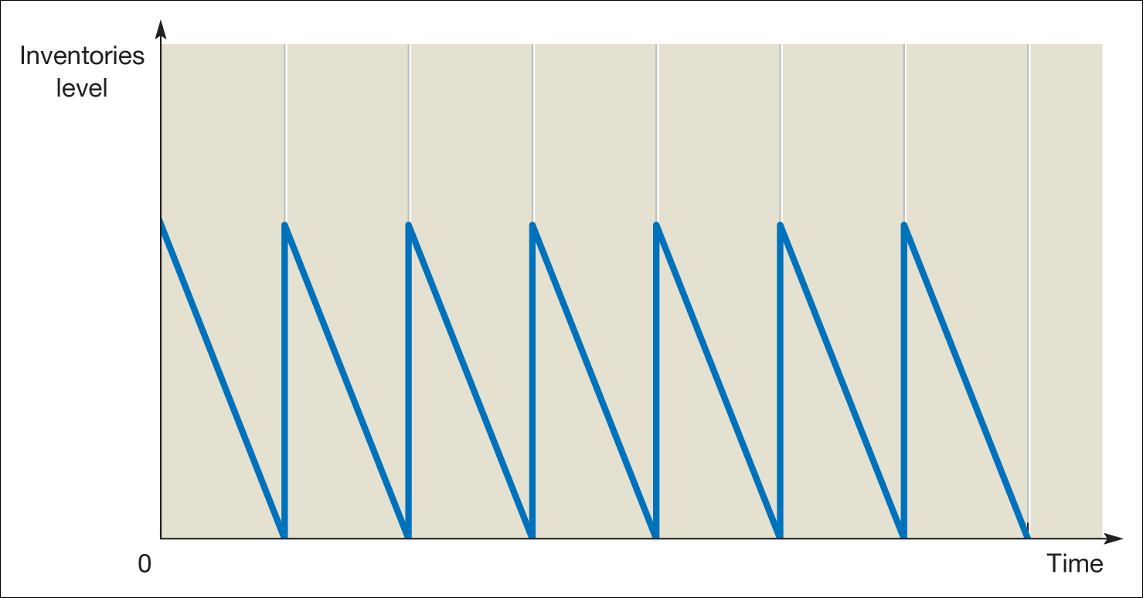
Patterns of inventories movements over time

Slide 21
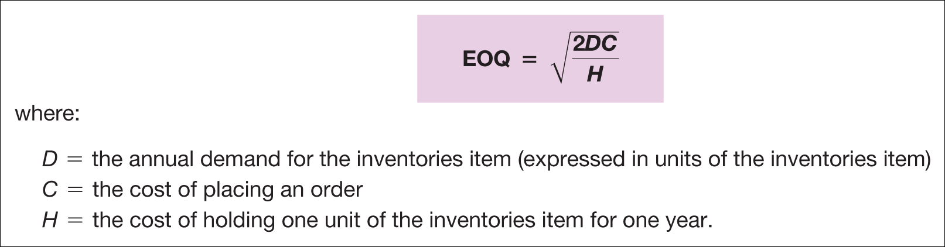
The economic order quantity (EOQ) model

Slide 22
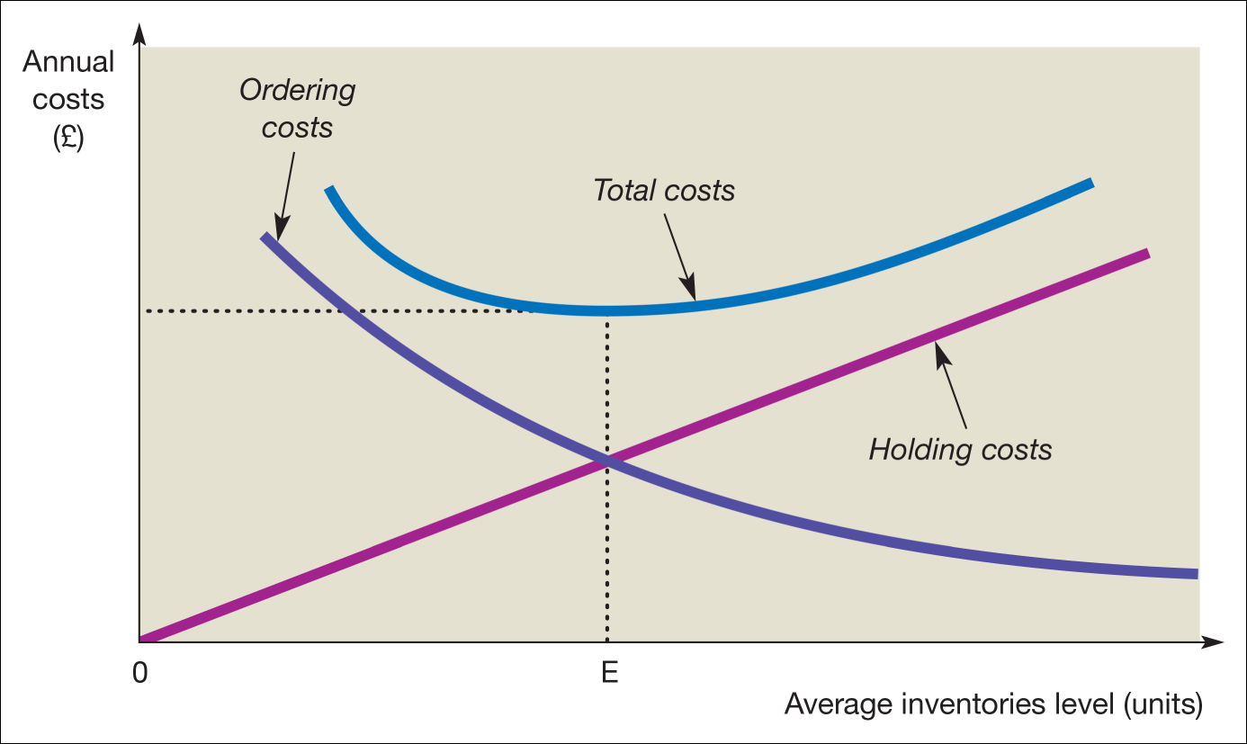
Inventories holding and order costs

Slide 23
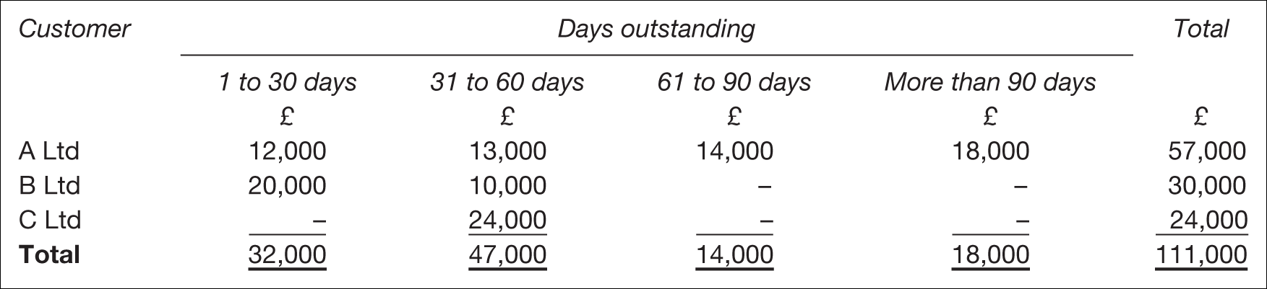
Ageing schedule of trade receivables at 31 December

Slide 24
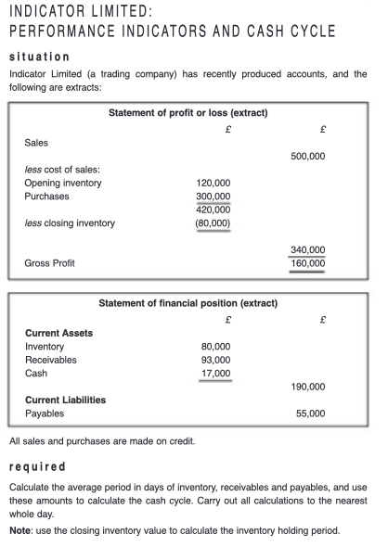

Slide 25
